Slide 1


What's a developer to do with that Golden Key?
Boston Code Camp – November 18, 2017
Beth Wolfset, Data Architect Email: beth.wolfset@insight.com
Twitter: @beth_wolfset
Notes:
Similar presentation given at:
SQL Saturday Albany – July 29, 2017
The Data Team is talking about Master Data Management. But why should a developer care? In this presentation you will learn the different types of data mastering and how you can interact with them for your application.

Slide 2
About BlueMetal
Modern technology, craftsman quality.
We’re an interactive design and technology architecture firm matching the most experienced consultants in the industry to the most challenging business and technical problems facing our clients. Founded August 2010 and as of October 2015 we are an Insight company.
6 | YEARS IN OPERATION 5 | LOCATIONS 6 | SERVICE AREAS
4 | INDUSTRY SPECIALIZATIONS
Notes:
Locations: Boston, New York, Chicago, DC, Tempte
Service Areas:
Intelligent Customer Applications
Modern Business Applications
Real-Time Business
Hybrid Cloud
Modern Workplace
Branch Infrastructure

Slide 3

















Boston Code Camp 28 - Thanks to our Sponsors!
Platinum
Gold
In-Kind Donations
Silver
Bronze
Individual
Robert Hurlbut

Slide 4
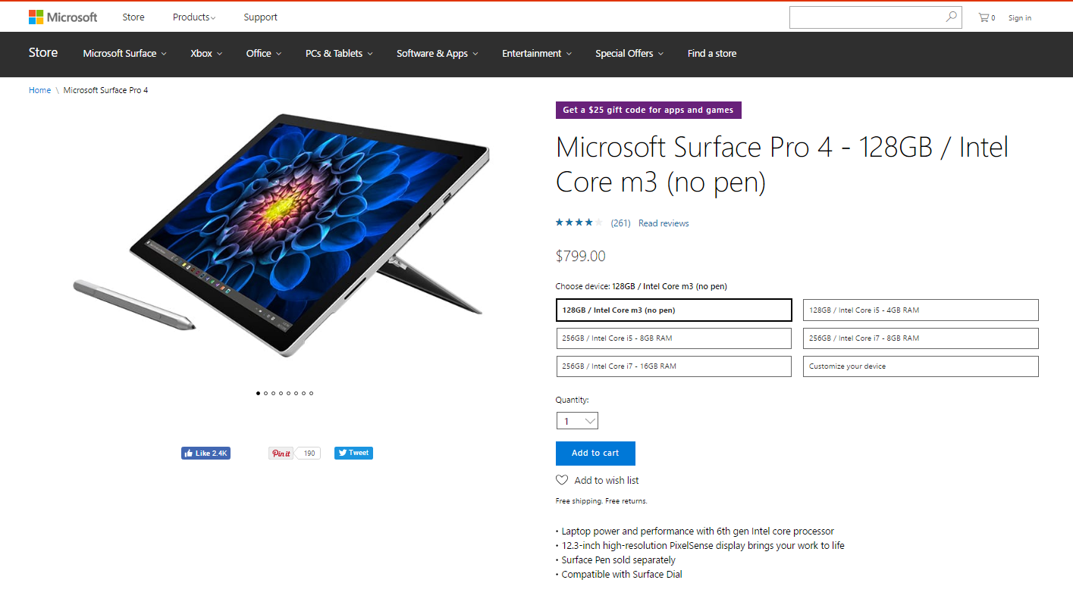
Requirement
Create an order entry application

Slide 5
JSON Example
{"customer": {
"name": {
"first_name": "Beth",
"last_name": "Wolfset"
},
“custId": "12345678",
"address": {
"street": "9 Galen Street",
"city": "Watertown",
"state": "MA",
"zip": "02472"
}
},
"type": "order",
"line item": {
"product": "Microsoft Surface Pro 4",
"options": {
"processor": "Intel Core M",
"memory": "4GB",
"storage": "128GB"
},
"price": 799
} }
Customer List
Valid State
Valid State, Zip code and City combination
Valid Transaction types
Product List
Product Component
Product Pricing

Slide 6

Identifying Common Data Objects
Across systems, similar objects are manifested with different data structures.
Logs
Taxonomies &
Reference Data
Events
Auditing
Business Objects
Demographic Data
Utilization
Notes:
When the same objects is represented different ways, it is difficult to get a cross functional look
In a transactional system, these are areas for master data management
In a warehouse, these will be transformed before storing
Predictive analytics efforts may have to perform manipulation
Master data can come from third party sources – especially reference data and taxonomies

Slide 7
Why Does the Data Team Care?
Minimize inconsistent definitions and usage across systems
Prevent duplicated efforts
Support data pulled from different sources
Protect against bad or missing data
CHAOS
AHEAD

Slide 8
Identifying Common Data Objects
Across systems, similar objects are manifested with different data structures.
Logs
Taxonomies &
Reference Data
Events
Company defined & standard protocols
Company defined & third party sources
Auditing
Business Objects
Demographic Data
Utilization
Company defined
Company defined & third party validation
Notes:
When the same objects is represented different ways, it is difficult to get a cross functional look
In a transactional system, these are areas for master data management
In a warehouse, these will be transformed before storing
Predictive analytics efforts may have to perform manipulation
Master data can come from third party sources – especially reference data and taxonomies

Slide 9

Master Data Management
Master Data
core data that is essential to operation of the business
consistent and uniform set of identifiers and extended attributes that describes the core entities
Master Data Management
a methodology that identifies the most critical information within an organization—and creates a single view of truth to power business processes
discipline in which business and IT work together to ensure the uniformity, accuracy, stewardship, semantic consistency and accountability of the enterprise’s official shared master data assets
may be technology enabled
Golden Key
typical reference to the id given to the mastered data
Notes:
Mastering is always about having disparate sources of data and brining it together. Three types of mastering:
Mutually exclusive – the data is different sources but there is no overlap. Mastering brings the sources into a single ‘list’ with a common structure. Example: class list across departments, vendor contract data
Vertically fragmented – the data is in different sources and there are attributes of the data that are different in these sources. Mastering creates a single view of the data that appears as if all attributes are in one master record. It is important to identify the source of the data by attribute in this type of mastering. Only one application can create a new record. However, different applications may be able to update – but only the attributes they are the source for. Example: most likely the plan list.
Match and merge – the data is in different sources and there is overlap of both rows of data and attributes within the data. Therefore, to master the data and provide a single view a complicated set of understanding the sources and attributes, ranking the owner, and recognizing the same information that arrives from those sources differently. These are the match and merge rules. Example: Provider data master.
Why Do MDM
Portal
Provides single logical view of data that is consistent and trustworthy information
Users see same data consistently across all applications and all plan
Efficiency
Reduces overhead
Integrate data
Compliance
Facilitates industry pressures and government mandates
Allows data integrity for data object
Reuse - Expedites computing in multiple systems, architectures, platforms and applications
Scalability - Support the projected growth

Slide 10

Handling Master Data
From the Application
Querying Master Data
Inserting Master Data
Editing Master Data
Take me to your Data!
Questions?
Time Check?
Notes:
Querying Master Data
Application queries directly from master db using a view, stored procedure or web service
Application copies data from master db to local db
Inserting Master Data
Should be through service
Has to determine if record already exists
May have to give golden record id
Editing Master Data
Directly on Master
Must report golden record key
Should call service that prioritizes changes from various systems
Local system that will be mastered later
Updates written – system merges later

Slide 11


Three Ways – Mutually Exclusive
Three Ways to Master Data
Mutually Exclusive
Vertically Fragmented
Match and Merge
Engineering Classes
Master Class List
Math Classes
Philosophy Classes
Notes:
Mastering is always about having disparate sources of data and brining it together. Three types of mastering:
Mutually exclusive – the data is different sources but there is no overlap. Mastering brings the sources into a single ‘list’ with a common structure. Example: class list across departments, vendor contract data
Vertically fragmented – the data is in different sources and there are attributes of the data that are different in these sources. Mastering creates a single view of the data that appears as if all attributes are in one master record. It is important to identify the source of the data by attribute in this type of mastering. Only one application can create a new record. However, different applications may be able to update – but only the attributes they are the source for. Example: most likely the plan list.
Match and merge – the data is in different sources and there is overlap of both rows of data and attributes within the data. Therefore, to master the data and provide a single view a complicated set of understanding the sources and attributes, ranking the owner, and recognizing the same information that arrives from those sources differently. These are the match and merge rules. Example: Provider data master.
Why Do MDM
Portal
Provides single logical view of data that is consistent and trustworthy information
Users see same data consistently across all applications and all plan
Efficiency
Reduces overhead
Integrate data
Compliance
Facilitates industry pressures and government mandates
Allows data integrity for data object
Reuse - Expedites computing in multiple systems, architectures, platforms and applications
Scalability - Support the projected growth

Slide 12
Three Ways – Vertically Fragmented
Three Ways to Master Data
Mutually Exclusive
Vertically Fragmented
Match and Merge
tCustomer
Customer Config
Sales Customer Data
Master Plan List
Notes:
Mastering is always about having disparate sources of data and brining it together. Three types of mastering:
Mutually exclusive – the data is different sources but there is no overlap. Mastering brings the sources into a single ‘list’ with a common structure. Example: class list across departments, vendor contract data
Vertically fragmented – the data is in different sources and there are attributes of the data that are different in these sources. Mastering creates a single view of the data that appears as if all attributes are in one master record. It is important to identify the source of the data by attribute in this type of mastering. Only one application can create a new record. However, different applications may be able to update – but only the attributes they are the source for. Example: most likely the plan list.
Match and merge – the data is in different sources and there is overlap of both rows of data and attributes within the data. Therefore, to master the data and provide a single view a complicated set of understanding the sources and attributes, ranking the owner, and recognizing the same information that arrives from those sources differently. These are the match and merge rules. Example: Provider data master.
Why Do MDM
Portal
Provides single logical view of data that is consistent and trustworthy information
Users see same data consistently across all applications and all plan
Efficiency
Reduces overhead
Integrate data
Compliance
Facilitates industry pressures and government mandates
Allows data integrity for data object
Reuse - Expedites computing in multiple systems, architectures, platforms and applications
Scalability - Support the projected growth

Slide 13
Three Ways – Match and Merge
Three Ways to Master Data
Mutually Exclusive
Vertically Fragmented
Match and Merge
Name: S. Snape
SSN: 123-45-6789
Degree: Engineering
Name: Prof. Severus Snape
SSN: 123-45-6789
Emp Id: 456
Address: 9 Galen St
Phone: 617-555-1212
Degree: Engineering
Name: Prof. Snape
Emp Id: 456
Phone: 617-555-1212
Name: Severus Snape
SSN: 123-45-6789
Address: 9 Galen St
Phone: 617-555-1212
Notes:
Mastering is always about having disparate sources of data and brining it together. Three types of mastering:
Mutually exclusive – the data is different sources but there is no overlap. Mastering brings the sources into a single ‘list’ with a common structure. Example: class list across departments, vendor contract data
Vertically fragmented – the data is in different sources and there are attributes of the data that are different in these sources. Mastering creates a single view of the data that appears as if all attributes are in one master record. It is important to identify the source of the data by attribute in this type of mastering. Only one application can create a new record. However, different applications may be able to update – but only the attributes they are the source for. Example: most likely the plan list.
Match and merge – the data is in different sources and there is overlap of both rows of data and attributes within the data. Therefore, to master the data and provide a single view a complicated set of understanding the sources and attributes, ranking the owner, and recognizing the same information that arrives from those sources differently. These are the match and merge rules. Example: Provider data master.
Why Do MDM
Portal
Provides single logical view of data that is consistent and trustworthy information
Users see same data consistently across all applications and all plan
Efficiency
Reduces overhead
Integrate data
Compliance
Facilitates industry pressures and government mandates
Allows data integrity for data object
Reuse - Expedites computing in multiple systems, architectures, platforms and applications
Scalability - Support the projected growth

Slide 14

Thank you.
Upcoming Speaking Engagements!
SQL Saturday Providence – Dec 9
Master Your Data using MDS
Inventory your data with Azure Data Catalog
NE SQL Server Users Group – Dec 13
Data Modelling & Predictive Analytics for Data Professionals
Beth Wolfset
beth.wolfset@insight.com
Twitter: @beth_wolfset

